Slide 1
Care Coordination Models for High-Risk People
Richard Crespo PhD
Marshall University School of Medicine
Stephanie Bowman NP, CDE

Slide 2
System for CHW-Based Chronic Care Management of
High Utilizer Patients
Clinic Referrals
Refer for ancillary and social services
Care Mgnt Team
-Provider (NP/PA)
-Nurse(s) CDE
-CHWs
Clinic Referrals
Home Visits
Risk Assessment and enrollment
Care Plan
Weekly Assessment
Patient Follow Up
Involve patient in community events (DSMP, DSME, gardening, walks, etc.)
Clinic Referrals

Slide 3
A CHWs Story

Slide 4
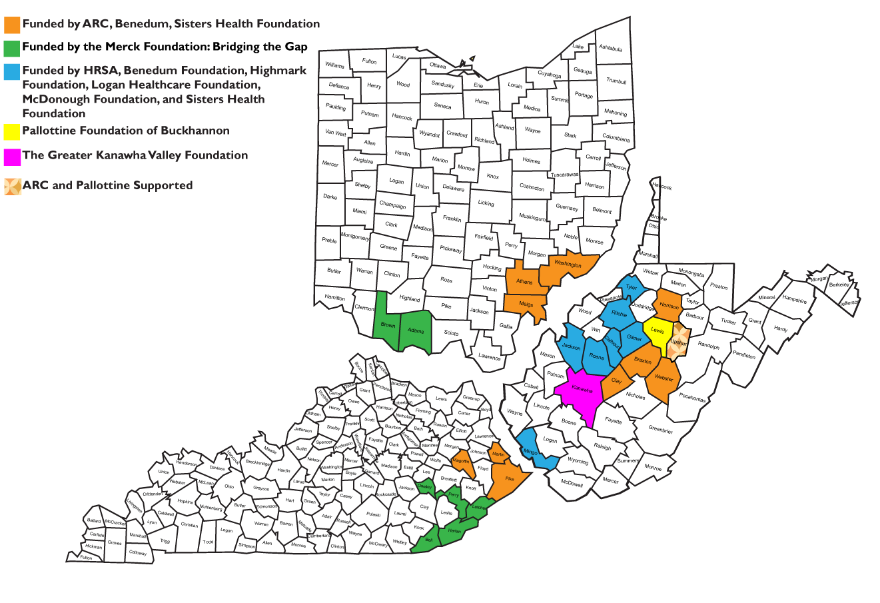

Slide 5
Partnering Agencies
West Virginia | Kentucky | Ohio
Cabin Creek (FQHC) Community Care of WV (FQHC) Minnie Hamilton Health Care (Rural Hospital) Jackson General (Rural Hospital) St. Joseph’s Hospital Buchannan (Rural Hospital) Williamson Health and Wellness Center (FQHC) | Big Sandy Health Care (FQHC) Mountain Comprehensive Health Corporation (FQHC) | Adams County Regional Medical Center (Rural Hospital)
 |  | Athens County Health Dept. Meigs County Health Dept. Washington County Health Dept. | Holzer Health Systems Ohio Health

Slide 6
Replication (Built on Relationships)
Rural Health Centers
Pt. Centered Med. Home
High Risk Patients
Funding Partnerships
Pitch: to Sustain CHW Workforce
Write like crazy . . .
Health Insurance Orgs
Observe and Learn Together
Partner in Payment Model

Slide 7
Funding Partners
McDonough Foundation
Sisters Health Foundation
Pallottine Foundation of Buckhannon
The Greater Kanawha Valley Foundation
Highmark Foundation
Claude Worthington Benedum Foundation
Appalachian Regional Commission – POWER Grant
Merck Foundation – Bridging the Gap Initiative
HRSA
Logan Healthcare Foundation

Slide 8
What is a CHW? (CHWs self definitions)
Person who makes connections
A walking resource person
Counselor
Patient advocate
Friend

Slide 9
What does a CHW do? (Self definition)
Bed bug assistance
Assist getting lamps, ramps, refrigerators, heating vouchers
Help patients organize meds
Give moral support
Help patients manage their schedules
Help apply for insurance, med assistance, public housing
Food assistance
Pet management
Community partnerships
Anything that will help my patients

Slide 10
Fundamental Functions of a CHW
The primary functions of the CHWs are:
Help people apply disease self-management skills in the context of their home and community.
Provide social and emotional support.
Link individuals with clinical, community and other resources and serve as a liaison between patients and the clinical care coordination team.
Provide ongoing, flexible, accessible support for patients as their needs change.

Slide 11
Enrollment to Date: 650 High-Risk Patients

Slide 12
Data as of 3/2019
A1C N=323 (with 2 or more A1c Tests
 | Patients | Percent | Mean Baseline A1c | Mean Last A1c | Percentage Point Difference
Improved | 173 | 54% | 9.3% | 7.9% | Decrease 2 points
Worsened | 84 | 26% | 8.5% | 9.6% | Increase 1.1 points
Same | 66 | 20% | 8.7% | 8.7% | 0

Slide 13
Key Points
The care management team receives referrals of high-utilizer patients.
Eligibility is determined by risk assessment. The team does an assessment, enrolls patients, and develops care plans.
CHW is a member of the care management team and is a full time employee of the health care agency.
The role of the CHW is to encourage and support patients in their home and community. Their basic function is to equip patients with self-management decision-making and problem solving skills so that patients can control their condition.
Foundational assumption: improved outcomes → reduced costs → sustainable reimbursement from payers

Slide 14
Sustainable Employment for Community Health Workers in Rural Communities
MU Team Provides:
Approach:
Providers hire CHWs who are local to the community
Care team = CHW + RN + NP/PA under the management of the PCP
Care team manages the needs of the patient to improve patient outcomes
Build the rural evidence base
Training/TA/support for providers and CHWs
Grant writing and project management
Convene payers re: quality measures and reimbursement
Evaluation of health outcomes and cost savings
Notes:
Approach:
Local providers hire CHWs for care coordination
Care team = CHW + RN + Advanced practice
Build evidence of health improvements + cost savings
MU roles:
Training/TA for providers and CHWs
Convene payers re: QC and reimbursement
Evaluate health conditions + cost savings

Slide 15
System for CHW-Based Chronic Care Management of
High Utilizer Patients
Clinic Referrals
Refer for ancillary and social services
Care Mgnt Team
-Provider (NP/PA)
-Nurse(s) CDE
-CHWs
Clinic Referrals
Home Visits
Risk Assessment and enrollment
Care Plan
Weekly Assessment
Patient Follow Up
Involve patient in community events (DSMP, DSME, gardening, walks, etc.)
Clinic Referrals

Slide 16
What works for you?
Primary functions of CHW
Help people apply disease self-management skills in the context of their home and community
Provide social and emotional support
Link individuals with clinical, community and other resources and serve as a liaison between patients, the clinical care coordination team, community resources.
Provide ongoing, flexible, accessible support for patients as their needs change.
Analytical Task
Who is your target population?
Who should be on the care coordination team?
What is the role of a CHW in your situation?

